Slide 1
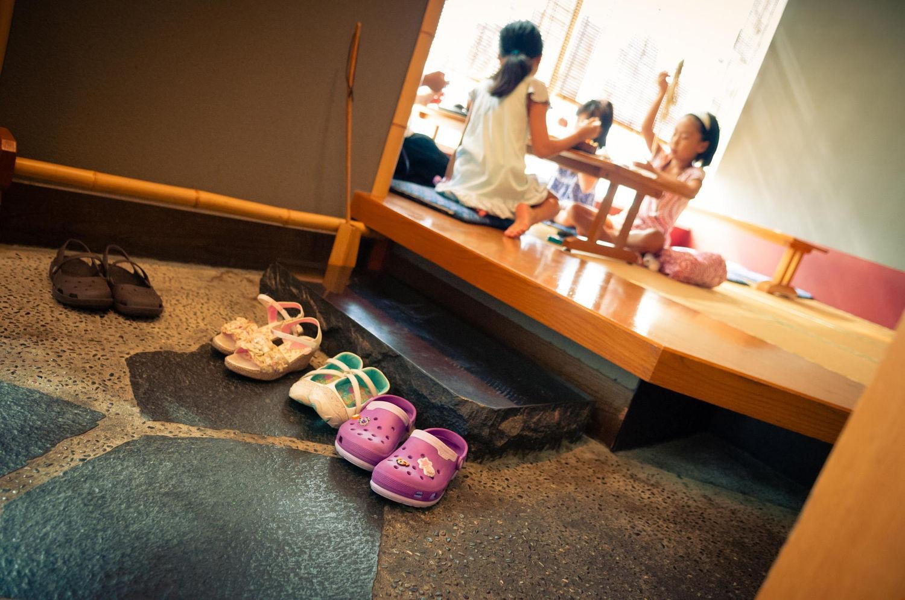

Cozy and clean homes

Slide 2

Our Mission
We hope to bring:
Well designed
Economical
Green
homes to everyone

Slide 3
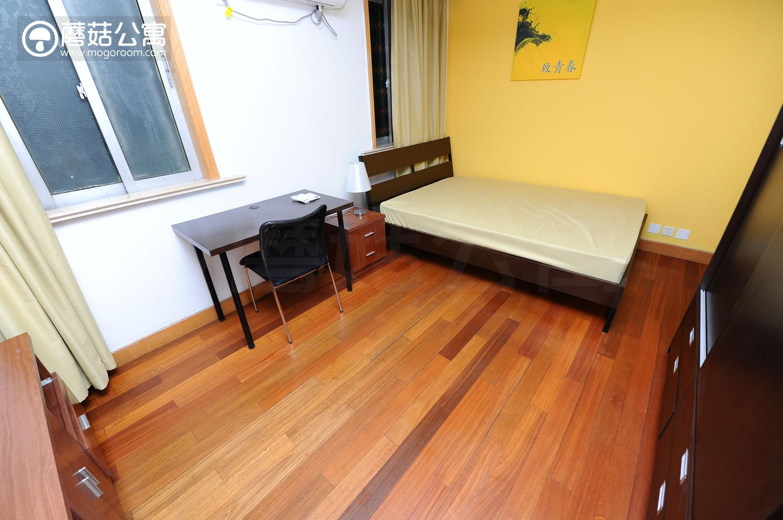
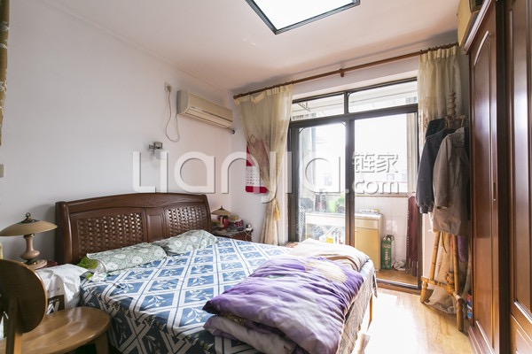
The problem
Most of the living rooms in our cities:

Slide 4

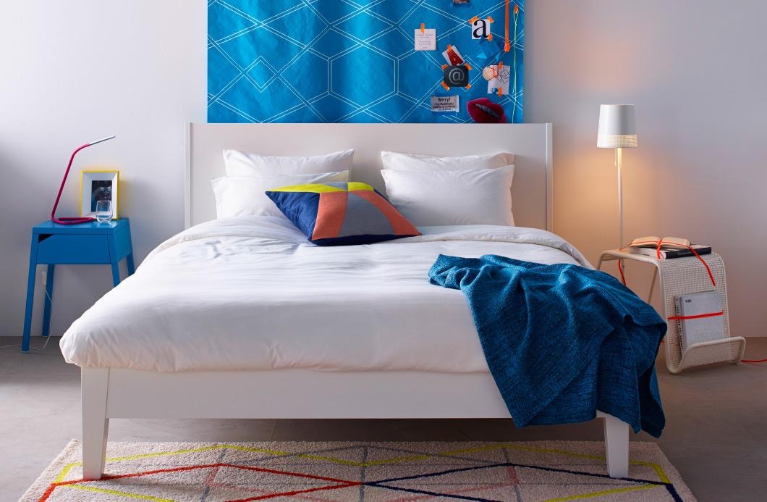
But we can live much better: cozy, clean & green

Slide 5

Our solution
By providing beautiful & customized room designs to help people live
in a green, economical, clean way;

Slide 6
How it works
Step 1
Meanwhile
Then
We will build a suppliers and logistics echo system
We will build the indoor design team, and also build an app for people to search for designs and rooms
We will launch our app, build our brand, starting from Shanghai

Slide 7
Market Analysis
• There are around 24,000,000 people living in Shanghai;
• We believe there is really a lot to improve for most living rooms in Shanghai;
• Every individual wants a well designed and clean home, while most house owners simply don’t have such motivations;

Slide 8

Competitors
Ikea: Ikea provides economical, green & elegant home designs, from which we can really learn a lot.

Slide 9


Our team
We are all experts in our fields and we are devoted to solve this problem
Huaishun Hu
A full stack developer and also a product manager, who has working experiences in CBN & Bilibili

Slide 10
Thank you : )

